Slide 1
Movie Now
UR Xtech
Julio A. Silva, Kaden Goski, Paul Wangwe
December 2nd, 2019

Slide 2
Our project vision
The “Golden Circle”
Why – To make it simpler and easier to review/find new movies.
How – With our team
What – A website to review movies

Slide 3
Our project vision
What exactly are you doing?
A user friendly website that allows users to look for reviews as well as write them and even vote for the best one in order to filter them.
What gap are you trying to fill?
There are a lot of movie review websites out there, the main difference with ours is that we are only showing relevant information.
Project vision: A website
Rationale: Current movie review options shows irrelevant/paparazzi(ish) information with their designs.
Stakeholders: Users who just want to see reviews when they are looking for a movie to watch
Assumptions: Our website has the latest movies in its database where you can visualize reviews.
Constraints: Time

Slide 4
Team work/responsibilities
All of our team members did a bit of everything.
We divided the work in two processes:
Developing/Coding
Documentation
On milestone 1 and 2, Kaden and Julio focused on the prototypes and the design, whereas Paul worked on documentation.
On milestones 3 and 4, Kaden did the majority of the coding. Julio and Paul would rotate between documentation and coding.

Slide 5
MVP 1 Recap
HTML/CSS was done.
Our website did not dynamically display data or display profile/user information when logged in.
The basis of our website, reviewing movies, was not implemented at all.
A long ways off from a finished product!...

Slide 6
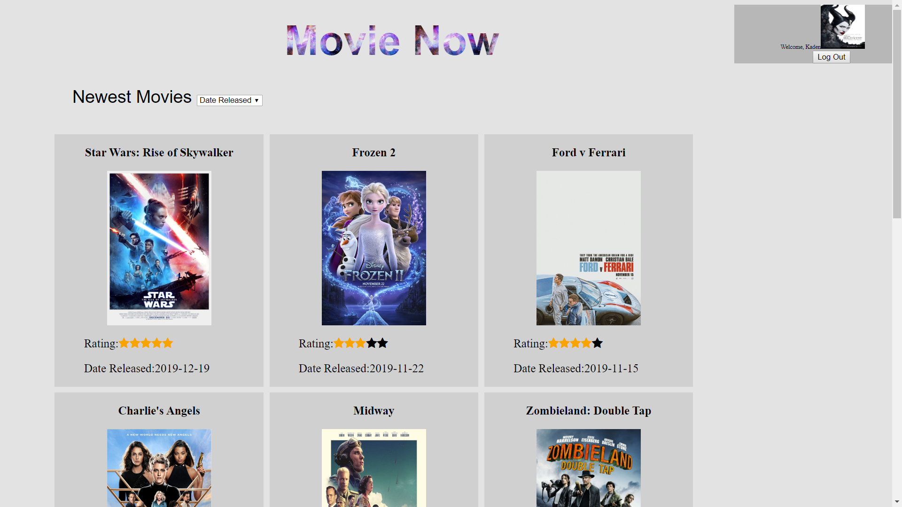
MVP 2 demo
What are things you really like?
The basic functionalities, users can sign up, log in, write reviews and rate them.
What are things you think might need some tinkering?
Definitely design/CSS displaying.
Some security things with SQL injection vulnerability, etc.
MVP 1 and MVP 2
In MVP 1 only the login and sign up functionalities were working
In MVP 2 users are able to write reviews and rate them.
PHP/AJAX/JS dynamically display upvotes/downvotes for reviews, sorting movies on homepage and posting reviews.
User profile picture displayed with logout button to destroy session.

Slide 7
MVP 2 demo
http://www2.cs.uregina.ca/~ktg349/MovieNow/homepage.php
Testing Account:
Username: ktg349@uregina.ca
Password: Testp@2s
(Required a symbol/number in the password… lead to issues getting it written correctly in presentation with a different keyboard layout. Likely should have just had an easy password.)

Slide 8
Feelings, future MVPs & GitHub
Feelings
Do you consider your project a success
Highlights:
Simple design
Its functionality
Easily scalable
What are some “better-ifs”
Way better and cleaner CSS design
More movies, looked at movie scraping to automatically add movies to the DB.

Slide 9
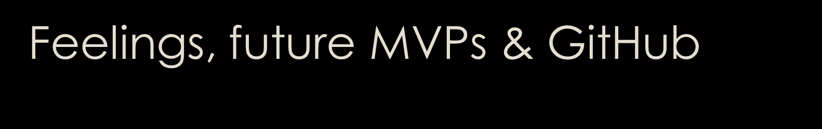
How many changes/direction shifts did your team take?
At first we were working on an android application but switched to a website system
We also changed our database from WebSQL to MySQL
Do you consider your code clean? Why/why not? Recommendations?
Our code is fairly clean. However, some of our variables names could be thought out better.
The commenting could be a little more consistent and explain what is going on throughout each php block. I.E; Not just at major junctions.
Our code rarely repeats itself, when it does it is out of necessity. PHP not running in one if statement could mean that the variable is not yet initialized with a value so it has to be initialized for redundancy.

Slide 10
Feelings, future MVPs & GitHub
Discuss what your team envisioned for potential next MVPs
Change Design/CSS
Let users edit their profile information
Implement a type of chat so users can talk between them.
Review your team’s GitHub
Github link: https://github.com/alpacamusical/Project-ENSE-374
Our github is clean and concise. It has a limited structure but this allows it to be easily navigated.

Slide 11
Group reflection
How did you feel about this project? What did you like about it? What did you dislike?
We learned our weaknesses and strengths, at first it was difficult to decide which tools to use or on what tasks people should tackle first.
What did you learn about yourself as you collaborated and worked through this project?
That we can get better results as teams rather than individuals.
How will you use what you have learned going forward?
On future projects we will make things right, instead of jumping right into coding we will analyze requirements and design so we can avoid errors.
What “stuff & things” related to this project would you want help with? – Could have been better?
JavaScript/AJAX and some PHP nuances.

